Slide 1
Mathematics for AI

Slide 2
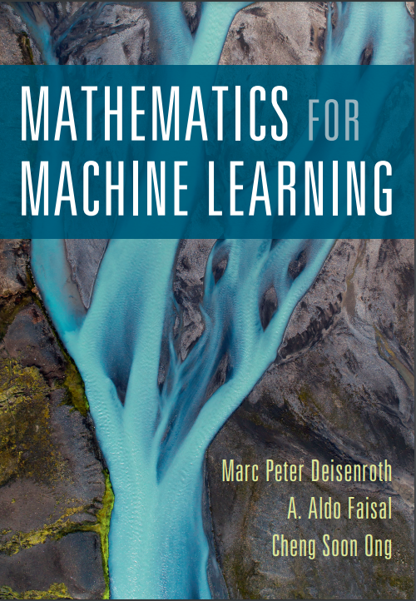
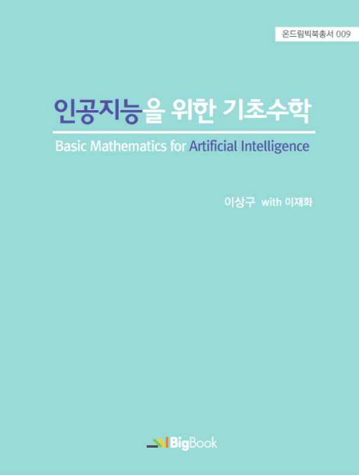
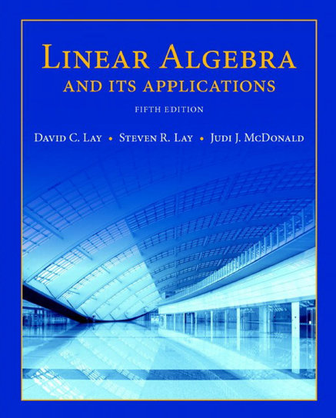
Textbook and References

Slide 3
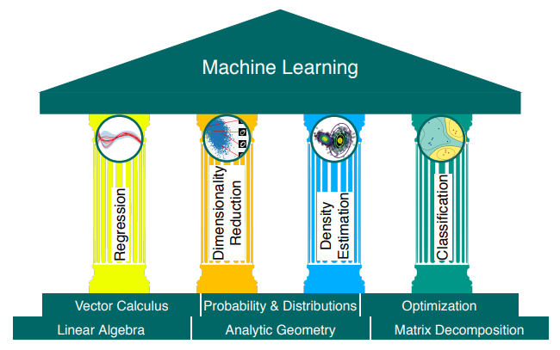
The foundations and 4 pillars of ML

Slide 4
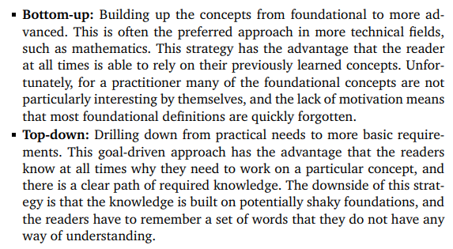
Bottom-up vs. Top-down

Slide 5
Course Schedule
week.1
week.2 ~ 3
week.4 ~ 5
week. 6 ~ 7
week.8 - 9
week.10 ~ 11
week.12 ~ 13
Week.14 ~ 15
Course introduction
Vector
When Models Meet Data
Linear Regression
Dimensionality Reduction with PCA
Density Estimation with GMM
Classification with SVM
Mid-term examination
“Mathematics for Machine Learning“ Marc Peter Deisenroth
Linear Algebra
Analytic Geometry
Matrix Decomposition
Vector Calculus
Probability and Distribution
Continuous Optimization
Project Presentation
Final examination
Class: Mon. 9am ~ 12pm
Office Hour: Mon afternoon @231, W19, or over kakaotalk (010-6799-6636)

Slide 6


Each class will consist of
10 min Re-cap of the previous week (occasionally with Quiz)
50 min Lecture on key concepts
30 min Breakout session
30 min team presentation
30 min Q&A and wrap-up

Slide 7
Evaluation Criteria
Grade Guideline
Relative evaluation
Fail for those who haven’t attend the class more than 1/3
20% Attendance
40% Mid/Final Term Exam
20% Participation
(In-class Exercise, Assignment, Quiz)
20% Final Project

Slide 8
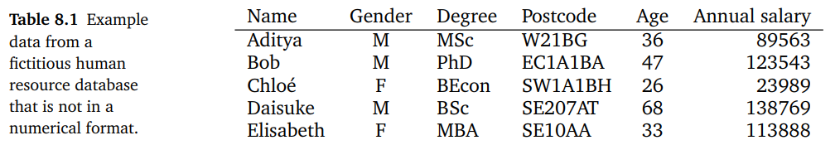
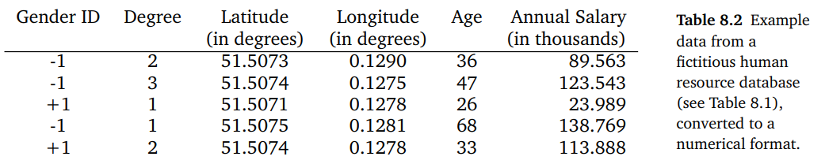
Data

Slide 9
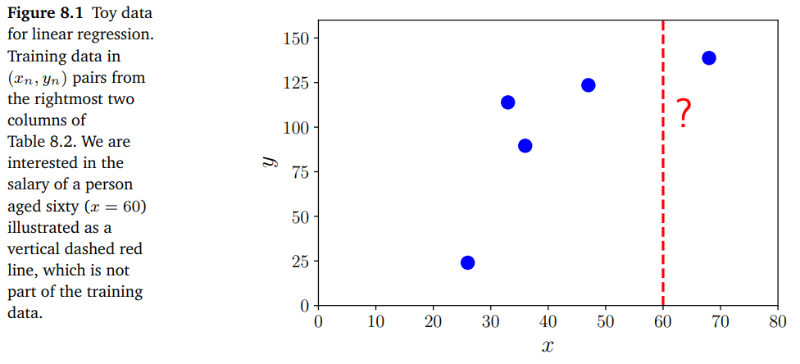
Regression

Slide 10
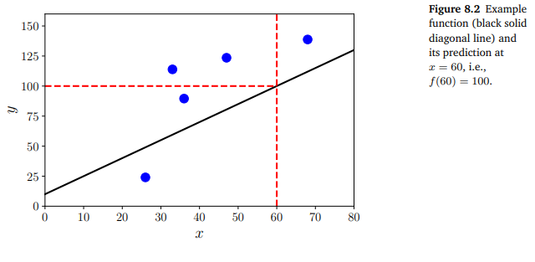
Regression

Slide 11
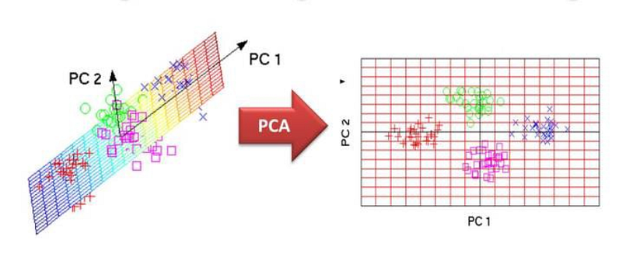
Dimensionality Reduction - PCA

Slide 12
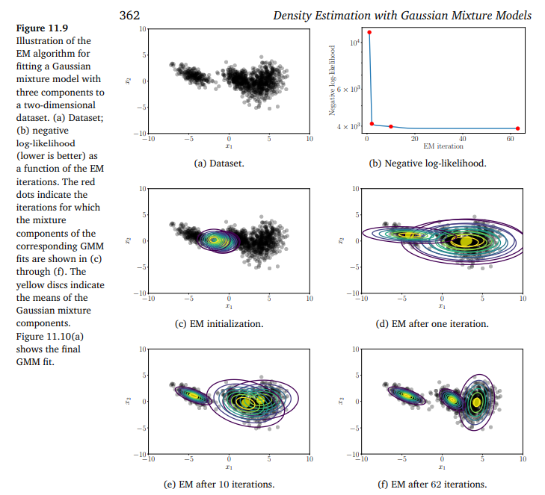
Density estimation with Gaussian Mixture Model

Slide 13
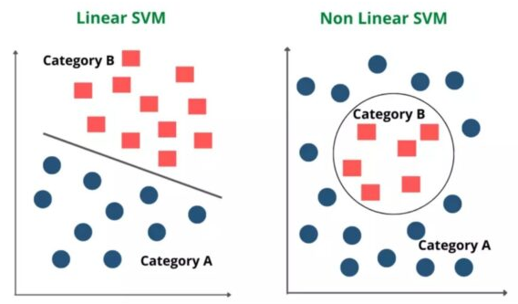
Classification with Support Vector Machine

Slide 14
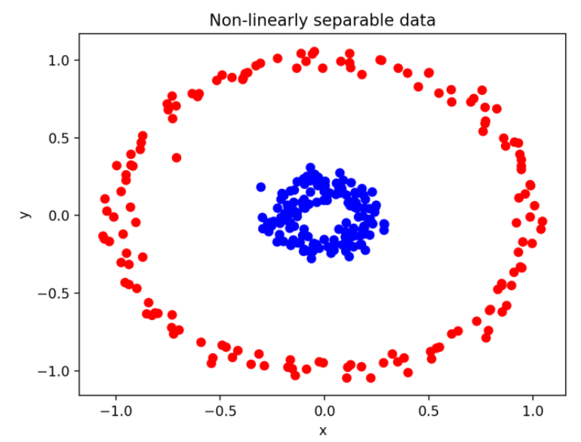
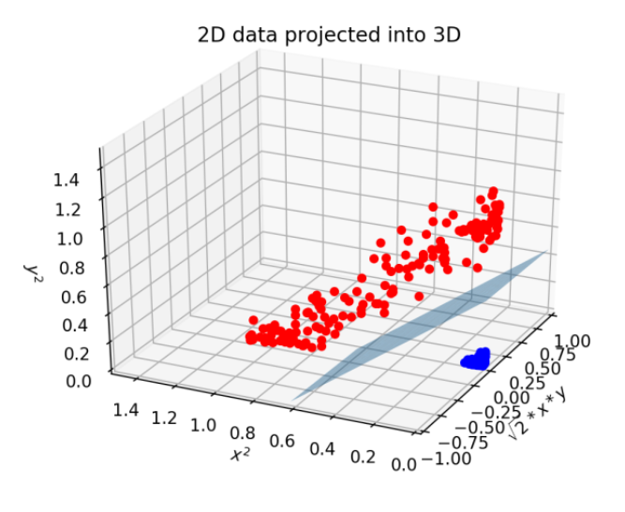
Classification with Support Vector Machine

Slide 15
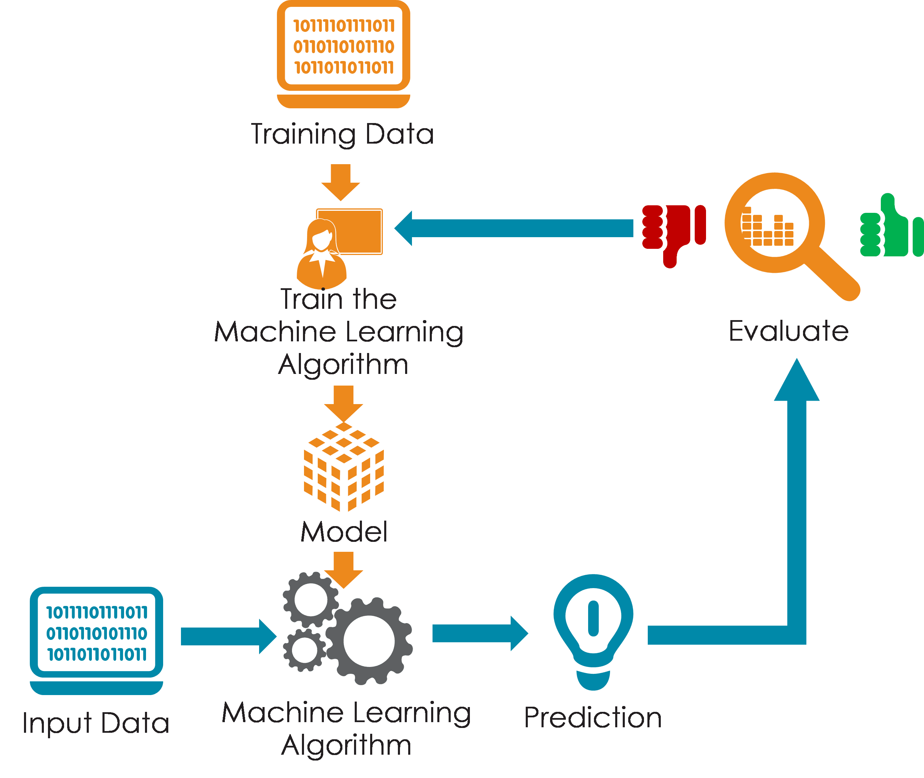
Data, Model and Learning

Slide 16
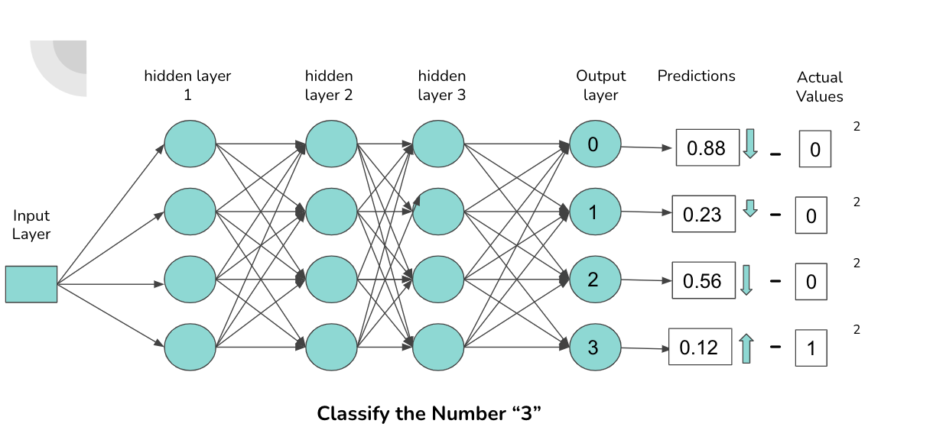
Data, Model and Learning

Slide 17
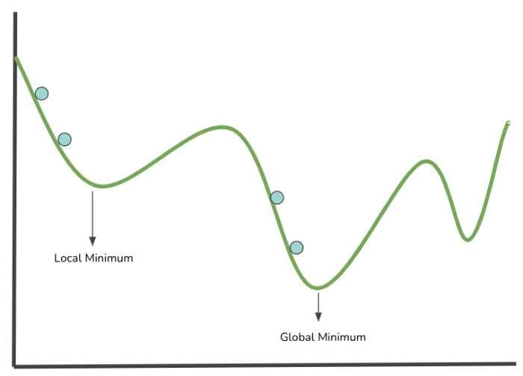
Data, Model and Learning

Slide 18
Preliminary Studies
Vector
Dot Product
Matrix

Slide 19
Exercise
Form a Team – 7 people / team
Read Chapter 8. When Models Meet Data

Slide 20
Next Week
When Models Meet Data

Slide 21
BongGyun Kim
Office hour: Mon. 2pm ~ 6pm
@ room 231, building W19
Phone: 042-629-6636
Mobile: 010-6799-6636
bonggyun.kim@endicott.ac.kr

Slide 22
End of Week 1

